Slide 1
Automation Framework

Slide 2
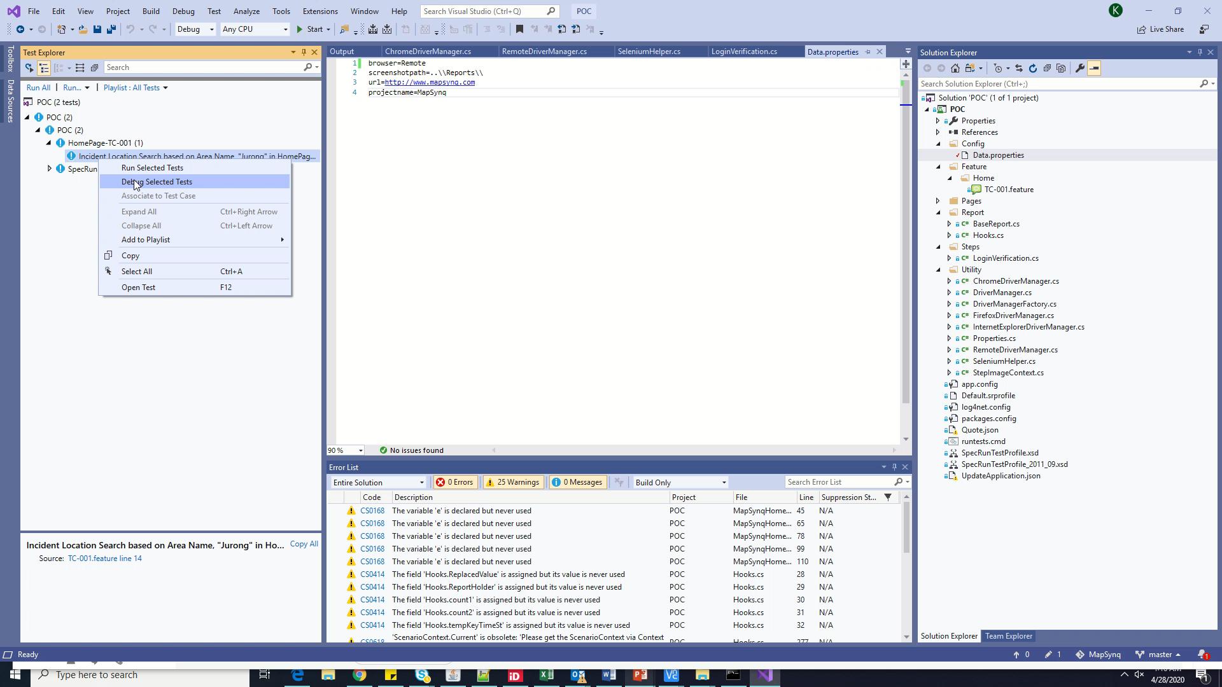
Containerized Run Demo

